Slide 1
EE435 Final Project
Mask Detection
Member: Yinda Du, Yuhan Gao

Slide 2
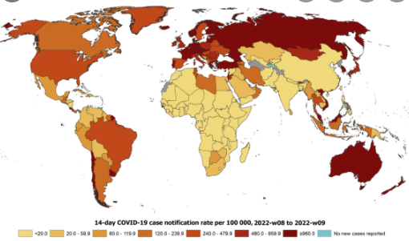
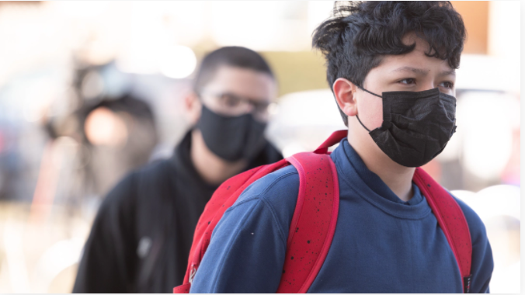
About the project
Covid-19 pandemic
Importance of properly wearing mask
https://www.ecdc.europa.eu/en/geographical-distribution-2019-ncov-cases
https://blockclubchicago.org/2022/02/18/

Slide 3
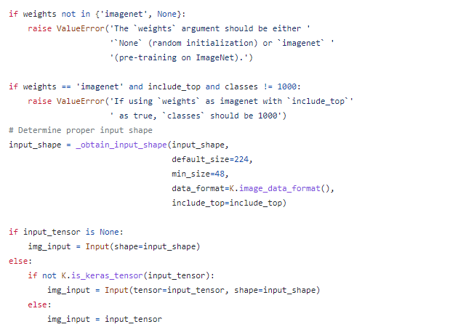
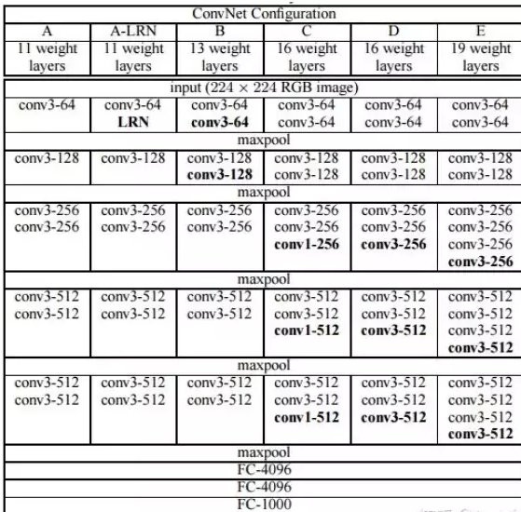
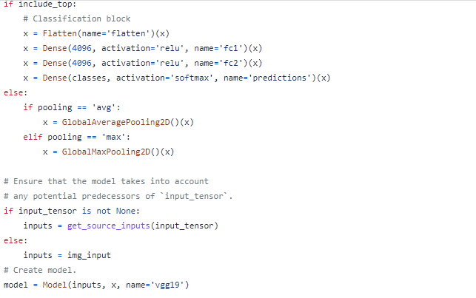
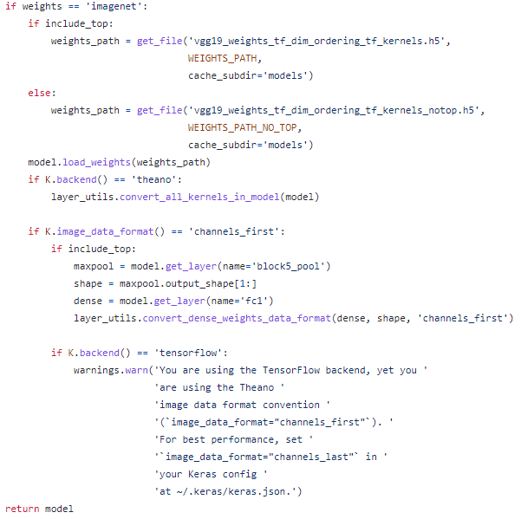
Model Introduction

Slide 4
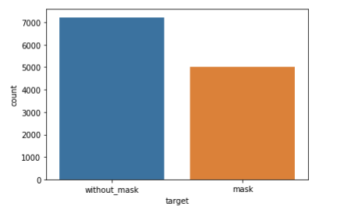
Our Implementation and result

Slide 5
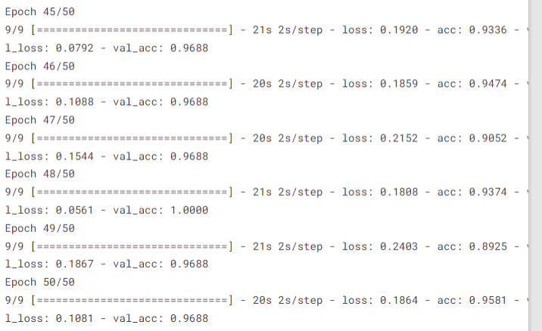
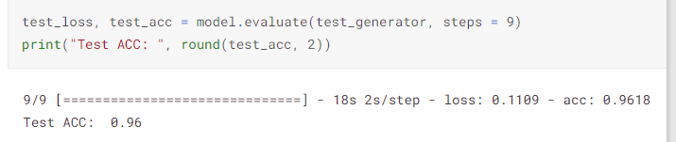
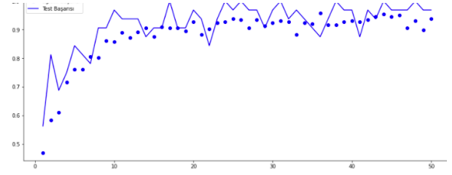
Our Implementation and result

Slide 6
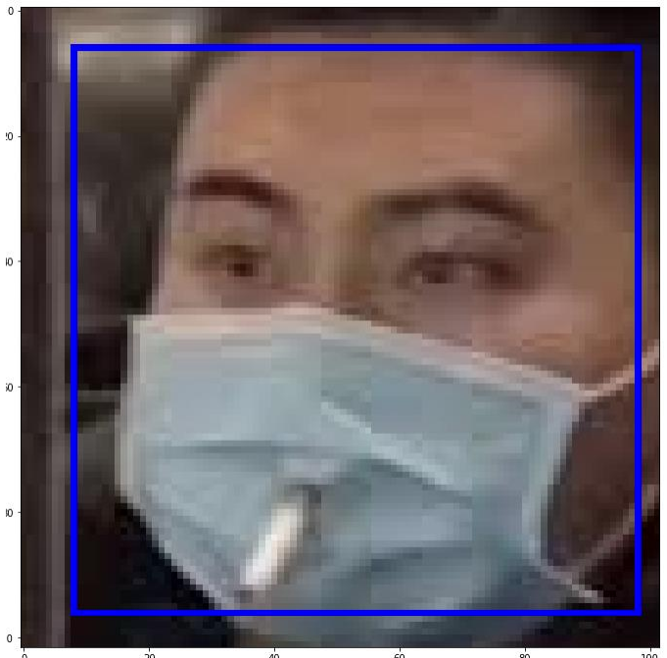
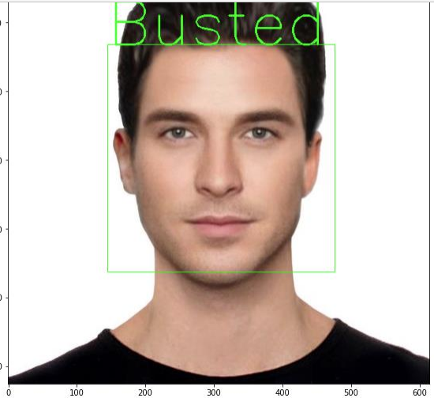
Our Implementation and result

